Slide 1

There is no way my presentation is cooler than this picture

Slide 2
Intro to scriptable debugging
VDB / VTrace

Slide 3
VDB / VTRACE
VDB is a debugger written using the vtrace API
GUI uses pyGTK
Written entirely in python
Extremely powerful debugging framework
http://www.kenshoto.com/vtrace/releases/

Slide 4
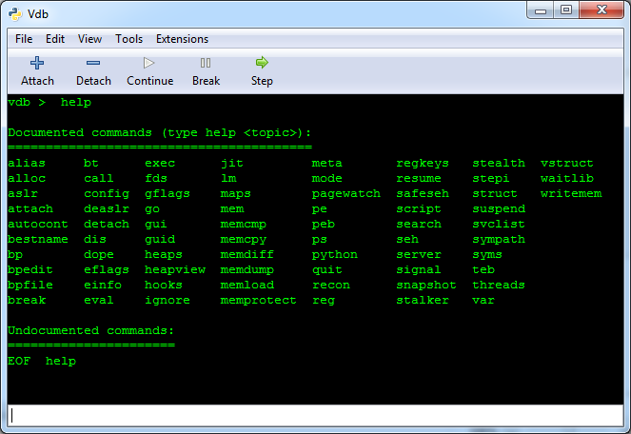
VDB BASIC USE
Command Line
python vdbbin
Gui Mode
python vdbbin –G
Server Mode
python vdbbin –S
Remote Connect
python vdbbin –R <host>
Basic documentation using help menu

Slide 5
WHY SCRIPTABLE?
Automate analysis
Look for common function calls
Track where your input variables go
Automate breakpoints based on state of the program
Faster analysis
Search memory for patterns
Patching of live systems
Alter the size of an input length or change a hardcoded password in memory
Malware Analysis
If done correctly the risk of infection or exploitation can be avoided by stopping execution before malicious portions of code

Slide 6
SAMPLE SCRIPT
import vtrace
if __name__ == "__main__":
pid = None
cmd = "C:\\pwnables100.exe"
# Get the current trace object from vtrace
trace = vtrace.getTrace()
# If attempting to attach to a 64 bit process
# 64 bit python is required.
if pid != None:
trace.attach(pid)
elif cmd != None:
trace.execute(cmd)
trace.run()

Slide 7
EXAMPLE SCRIPTS
Attach to a process/PID
Start a PE
Find OEP
Set a breakpoint on OEP
Print Register Contents
EIP, EAX, and ESP
Print OP Code for current EIP
Reading from memory
Finding Return address from a function
Searching DLL for a list of function names
Simple Notifiers
Dump info from breakpoints and step instructions
Memory Snapshot

Slide 8
FUTURE IDEAS
Vuln Discovery
Flag on any call to strcpy, strcat, printf, gets, fgets
Calculate buffer size for strncpy before it executes
VulnCatcher by @tlas does this as part of atlasutils (among other things).
Follow child process (Harder than it sounds)
Windbg already has the ability for this with .childbg 1
Change permissions on Import Address Table (IAT) so all external functions can be tracked
Catch the exception signal that is thrown and continue on
Notifier that prints out each EIP touched
Useful as a way to colorize IDA while pulling useful info
Hot Patching running executables to fix vulnerabilities (useful for ctf competitions)
Emulation

